Slide 1
DOE’s ROSE Software Uses NMI Testing
ROSE is a DOE compiler infrastructure
  Supports C/C++, F2003, OpenMP, UPC (1.5M LOC)
  Open source software analysis/transformation framework
  Basis for research on software optimization
  Dozens of research groups worldwide, 2300+ downloads last year
  Auto-parallelization support for OpenMP research
  Basis for numerous tools at different DOE labs
Uses NMI support for nightly tests on 35+ platforms critical to our customers (continuous integration and release system)
NMI provides transparency of robustness of ROSE to users
NMI is used by DOE to test our Open Source software
  Open source software must be portable (NMI can scale)
  Portability requires huge amount of testing on different platforms
Work is ongoing to improve our software development process

Slide 2
ROSE defines a development process that uses NMI efficiently
Our process starts with a distributed source code repository…
  “git” is a distributed source code repository system
    Developed to support distributed development of Linux
    Can support a hierarchy of local repositories (scalable)
    By contrast, SVN is a central source code repository system
Continuous Integration is used to test branches before merging…
Continuous Deployment is used to make automated software releases…
NMI is used to test the software releases (results are posted on our web)
Future use of NMI will trigger roll back to “best” of latest releases
Developer A
branch X
git
Many developers can interchangeably use many branches and many local repositories
- Only one “master” branch
- Developers can share branches
- Can form complex hierarchies to define scalable solutions to large scale collaborative software development
local
repo
Developer B
branch Y
Developer C
branch Z
shared
repo
Developer D
branch X
Developer E
branch Y
local
repo

Slide 3
Continuous Integration/Deployment and NMI provide a scalable development process
“git” distributed source code repository
“Hudson” for Continuous Integration
3 platform testing for Continuous Deployment
NMI for critical comprehensive testing (35+ platforms)
Future work will use NMI to trigger release roll back
Continuous Deployment
(3 platforms, twice daily)
NMI
(35+ platforms)
nightly tests
Developers
Continuous Integration
(5 compiler tests)
“git commit”
sucess
“git push”
sucess
SciDAC
web site
at DOE
fail
Git shared
repository
fail
Git local
repository
STOP
STOP
Daily
Report
No check-in to
“master” branch
No external
release
Notes:
Continuous integration itself refers to the practice of frequently integrating one's new or changed code with the existing code repository. This must be carried out frequently enough that there is no intervening window between commit and build, such that errors can arise without them being noticed and corrected immediately. We trigger these builds by every commit to our repository, rather than a nightly (or weekly!) scheduled build.
Continuous Deployment is a process by which software is released several times throughout the day – in minutes versus days, weeks, or months. Continuous Flow Manufacturing is a Lean technique that boosts productivity by rearranging manufacturing processes so products are built end-to-end, one at a time (using singe-piece flow), versus the more prevalent batch and queue approach.
Continuous Deployment is Continuous Flow applied to software. The goal of both is to eliminate waste. The biggest waste in manufacturing is created from having to transport products from one place to another. The biggest waste in software is created from waiting for software as it moves from one state to another: Waiting to code, waiting to test, waiting to deploy. Reducing or eliminating these waits leads to faster iterations which is the key to success.

Slide 4
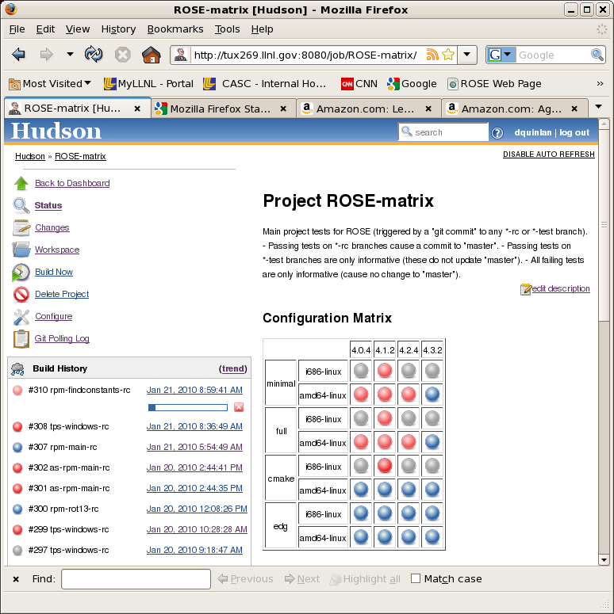
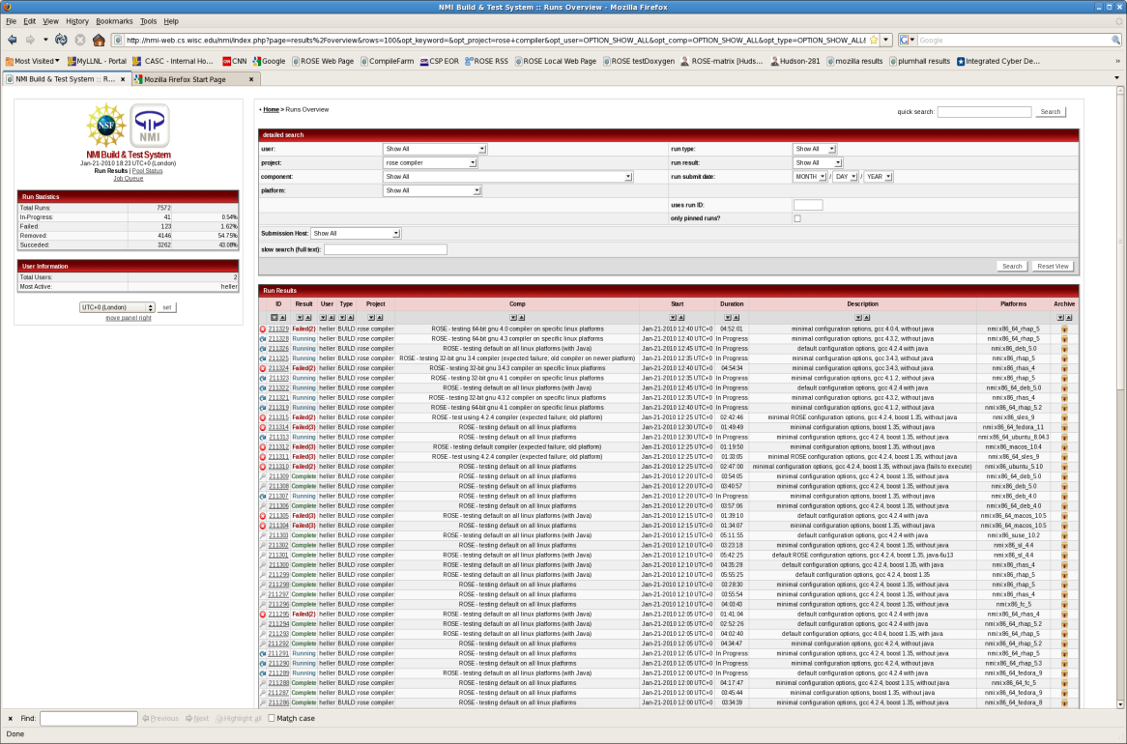
NMI Nightly Tests
Builds Robust DOE Software
NMI make possible the most comprehensive tests available to DOE
For the ROSE project this provides transparency to our users
  Presents options used for each build
  Instantly communicates robustness
We have noticed 50% improvement in downloads since using NMI
We have measured 500% improvement in portability via NMI testing
Continuous Integration
Continuous Deployment
NMI Nightly Testing

Slide 5
NMI Used for Continuous Integration, Deployment and Testing
Hudson for “Continuous Integration”
3 platform testing for automated “Continuous Deployment”
NMI for critical comprehensive testing (35+ platforms)
ROSE
Developer
Continuous Deployment
(3 platform tests)
NMI
Nightly Tests
(35+ platforms)
software
“check-in”
software
release
DOE SciDAC
web site
Continuous Integration
(5 tests with different
compilers and build options)
Daily
Report
Link to web site

Slide 6
Backup slides

Slide 7
ROSE: generator of source-to-source translators developed for compile-time optimization
ROSE translators read in source code, apply custom analysis and transformations to the AST, and generate source code
ROSE currently processes C & C++, Fortran 2003, OpenMP, UPC, PHP and Binary executables (x86 and ARM; Elf and PE)
Support for languages important for government scientific computing and cyber-security research
ROSE Framework
User specified
using ROSE features
READ
ANALYSIS and TRANSFORMATION
GENERATE
Source Code
void PDE::Compute_Residuals ()
{
// The decision to implement the residual computation seperately is a design preference.
if (DEBUG > 0)
printf ("Compute Residuals! \n");
Residual = 0.0;
double Scaling_Factor = 1.0 / (Mesh_Size * Mesh_Size);
if (Problem_Dimension == 1)
{
Residual (I) = Right_Hand_Side (I) + Scaling_Factor * (
Solution (I+1) + Solution (I-1) - 2.0 * Solution (I) );
}
else
{
if (Problem_Dimension == 2)
{
if (Fully_Variational)
{
Residual (I,J) = Right_Hand_Side (I,J) + Scaling_Factor * (
Solution (I+1,J) + Solution (I-1,J) + Solution (I,J-1) + Solution (I,J+1) +
Solution (I+1,J+1) + Solution (I-1,J+1) + Solution (I+1,J-1) + Solution (I-1,J-1) -
8.0 * Solution (I,J) );
}
else
{
Residual (I,J) = Right_Hand_Side (I,J) + Scaling_Factor * (
Solution (I+1,J) + Solution (I-1,J) +
Solution (I,J-1) + Solution (I,J+1) - 4.0 * Solution (I,J) );
}
#ifdef GRAPHICS
Graphics_Object.setProperty(TOPLABEL,"Residual");
Graphics_Object.setProperty(CONTSTYLE,2);
Graphics_Object.setProperty(NSTEPS,10);
Graphics_Object.contour(Residual);
#endif
}
else
{
if (Problem_Dimension == 3)
{
if (Fully_Variational)
{
Residual (I,J,K) = Right_Hand_Side (I,J,K) + Scaling_Factor * (
// Center face
Solution (I+1,J,K) + Solution (I-1,J,K) +
Solution (I,J-1,K) + Solution (I,J+1,K) +
Solution (I+1,J+1,K) + Solution (I-1,J+1,K) +
Solution (I+1,J-1,K) + Solution (I-1,J-1,K) +
// Inner face
Solution (I+1,J,K-1) + Solution (I-1,J,K-1) +
Solution (I,J-1,K-1) + Solution (I,J+1,K-1) +
Solution (I+1,J+1,K-1) + Solution (I-1,J+1,K-1) +
Solution (I+1,J-1,K-1) + Solution (I-1,J-1,K-1) +
// Outer face
Solution (I+1,J,K+1) + Solution (I-1,J,K+1) +
Solution (I,J-1,K+1) + Solution (I,J+1,K+1) +
Solution (I+1,J+1,K+1) + Solution (I-1,J+1,K+1) +
Solution (I+1,J-1,K+1) + Solution (I-1,J-1,K+1) +
// Center point of Inner and Outer faces
Solution (I,J,K-1) + Solution (I,J,K+1) -
// Center point
26.0 * Solution (I,J,K) );
}
else
{
Residual (I,J,K) = Right_Hand_Side (I,J,K) + Scaling_Factor * (
Solution (I+1,J,K) + Solution (I-1,J,K) +
Solution (I,J-1,K) + Solution (I,J+1,K) + Solution (I,J,K-1) +
Solution (I,J,K+1) - 6.0 * Solution (I,J,K) );
}
}
}
}
if (DEBUG > 0)
printf ("Leaving Compute Residuals! \n");
// Swap sign for test!
// Residual = -Residual;
}
Main(){
asdf
sdfs;
sdfs
Asdfs
}
Source Code
{
// The decision to implement the residual computation seperately is a design preference.
if (DEBUG > 0)
printf ("Compute Residuals! \n");
Residual = 0.0;
double Scaling_Factor = 1.0 / (Mesh_Size * Mesh_Size);
if (Problem_Dimension == 1)
{
Residual (I) = Right_Hand_Side (I) + Scaling_Factor * (
Solution (I+1) + Solution (I-1) - 2.0 * Solution (I) );
}
else
{
if (Problem_Dimension == 2)
{
if (Fully_Variational)
{
Residual (I,J) = Right_Hand_Side (I,J) + Scaling_Factor * (
Solution (I+1,J) + Solution (I-1,J) + Solution (I,J-1) + Solution (I,J+1) +
Solution (I+1,J+1) + Solution (I-1,J+1) + Solution (I+1,J-1) + Solution (I-1,J-1) -
8.0 * Solution (I,J) );
}
else
{
Residual (I,J) = Right_Hand_Side (I,J) + Scaling_Factor * (
Solution (I+1,J) + Solution (I-1,J) +
Solution (I,J-1) + Solution (I,J+1) - 4.0 * Solution (I,J) );
}
#ifdef GRAPHICS
Graphics_Object.setProperty(TOPLABEL,"Residual");
Graphics_Object.setProperty(CONTSTYLE,2);
Graphics_Object.setProperty(NSTEPS,10);
Graphics_Object.contour(Residual);
#endif
}
else
{
if (Problem_Dimension == 3)
{
if (Fully_Variational)
{
Residual (I,J,K) = Right_Hand_Side (I,J,K) + Scaling_Factor * (
// Center face
Solution (I+1,J,K) + Solution (I-1,J,K) +
Solution (I,J-1,K) + Solution (I,J+1,K) +
Solution (I+1,J+1,K) + Solution (I-1,J+1,K) +
Solution (I+1,J-1,K) + Solution (I-1,J-1,K) +
// Inner face
Solution (I+1,J,K-1) + Solution (I-1,J,K-1) +
Solution (I,J-1,K-1) + Solution (I,J+1,K-1) +
Solution (I+1,J+1,K-1) + Solution (I-1,J+1,K-1) +
Solution (I+1,J-1,K-1) + Solution (I-1,J-1,K-1) +
// Outer face
Solution (I+1,J,K+1) + Solution (I-1,J,K+1) +
Solution (I,J-1,K+1) + Solution (I,J+1,K+1) +
Solution (I+1,J+1,K+1) + Solution (I-1,J+1,K+1) +
Solution (I+1,J-1,K+1) + Solution (I-1,J-1,K+1) +
// Center point of Inner and Outer faces
Solution (I,J,K-1) + Solution (I,J,K+1) -
// Center point
26.0 * Solution (I,J,K) );
}
else
{
Residual (I,J,K) = Right_Hand_Side (I,J,K) + Scaling_Factor * (
Solution (I+1,J,K) + Solution (I-1,J,K) +
Solution (I,J-1,K) + Solution (I,J+1,K) + Solution (I,J,K-1) +
Solution (I,J,K+1) - 6.0 * Solution (I,J,K) );
}
}
}
}
if (DEBUG > 0)
printf ("Leaving Compute Residuals! \n");
// Swap sign for test!
// Residual = -Residual;
}
Main(){
asdf
sdfs;
sdfs
Asdfs
}
Initial AST
Transformed AST

Slide 8
Components of ROSE
C/C++/Fortran
Source Code
EDG Front-end/
Open Fortran Parser
IDA Pro
(optional)
Software
Binary
EDG /Fortran-to-ROSE Connector
ROSE
Disassembler
Vendor
Compiler
Program Analysis
IR
USER
Program Transformation
Transformed
C/C++/Fortran Code
ROSE Unparser
ROSE

Slide 9
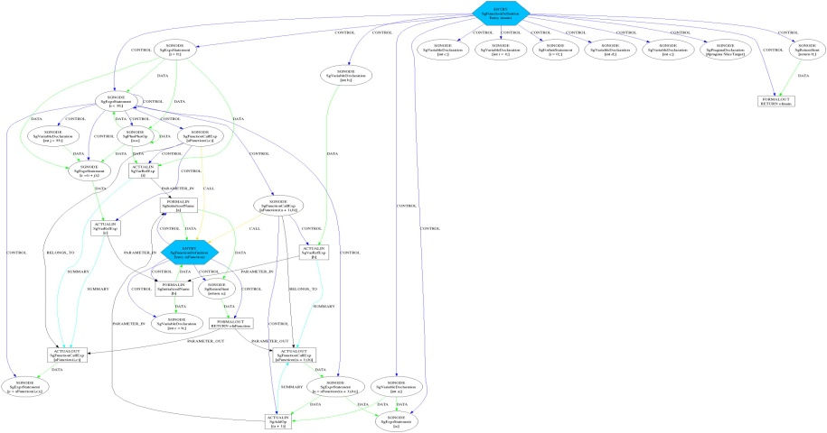
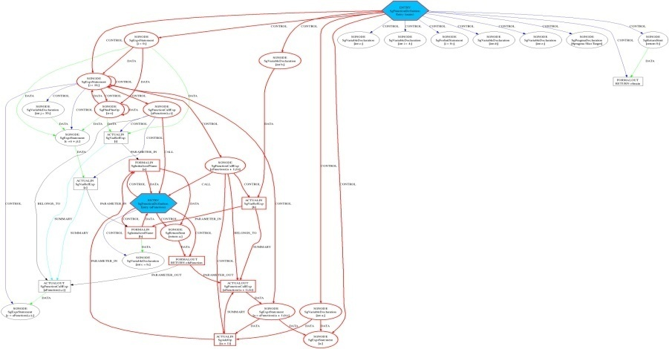
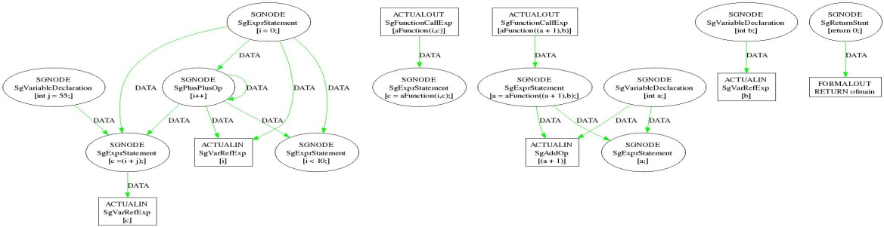
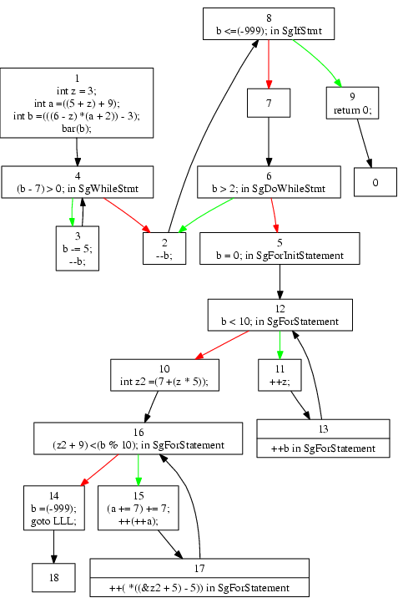
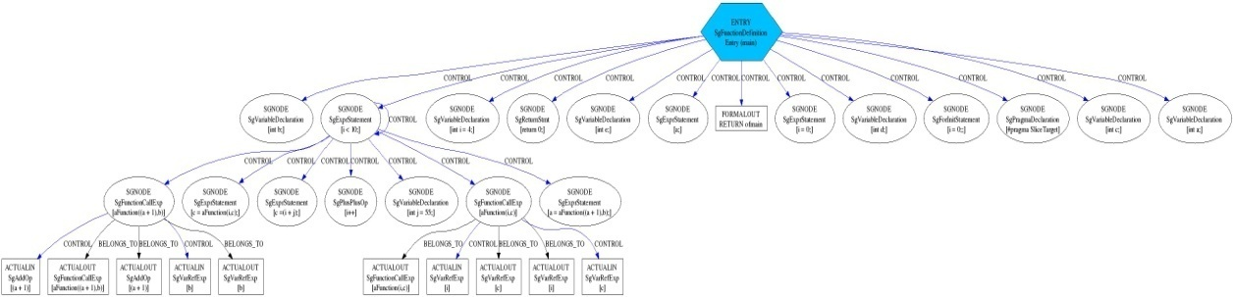
ROSE: Common forms of Program Analysis
Program analysis uses different graphs
  Abstract Syntax Tree (AST)
  Call graph analysis
  Class Hierarchy graph analysis
  Control flow analysis
  Dependence analysis
  System Dependence Graph (allows many forms of analysis, e.g. slicing)
  Whole Program Analysis (merged AST)
System-dependency
Sliced-system-dependency
Source Code
int aFunction(int a, int b)
{
int c=b;
return a;
}
main()
{
int a,b,c,d,e;
int i=4;
for (i=0;i<10;i++)
{
int j=55;
c=i+j;
c=aFunction(i,c);
a=aFunction(a+1,b);
}
#pragma SliceTarget
a;
return 0;
}
Data-dependency
Control-Flow
Control-dependency

Slide 10
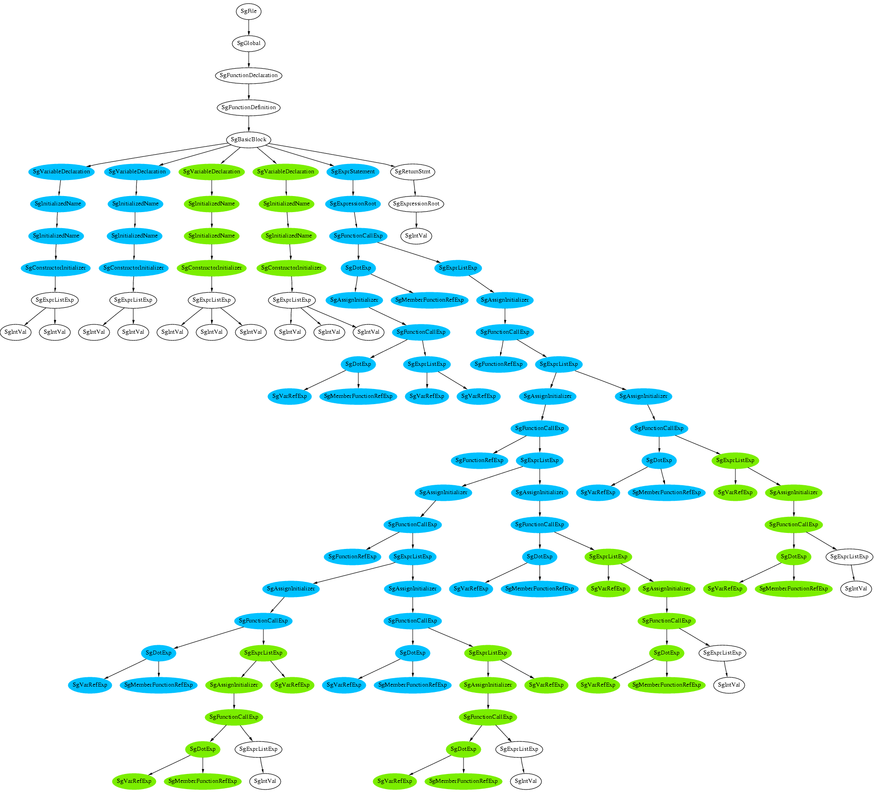
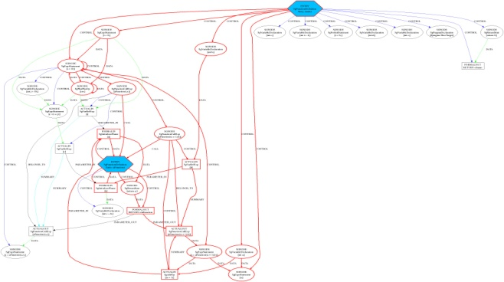
ROSE provides multiple graphs of software to support different forms of security analysis
Graph Type
AST
Control Flow
System
Dependence
Used to detect
Localized Structural
Security Flaws
Buffer Overflow
Vulnerability
Mixing trusted data with
untrusted user input

Slide 11
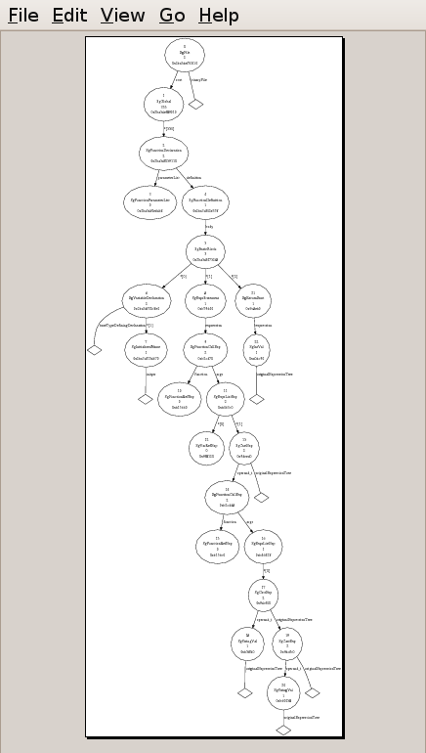
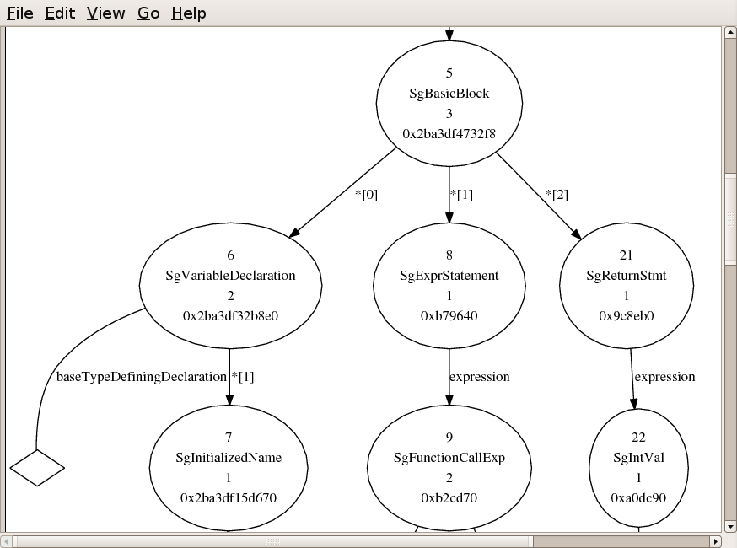
ROSE AST

Slide 12
Compass is an extensible tool for binary and source code analysis
Built using ROSE open compiler infrastructure (LLNL)
Automatically reports properties of binary executables and source code (140+ rules implemented; collaboration with CERT)
Future research will analyze binaries to identify malware
Collaboration with research groups in US government
Hundreds of rules left to implement (ongoing research work)
Eclipse
Compass
Emacs
Source
Code
ROSE
Violation
Handler
Violations
vim
Binary
Plug-in
Interface
QRose GUI
ASCII Text
Plug-in₁
Plug-in_{n}
Plug-in₂
…
140+ rules for analysis of software

